Slide 1
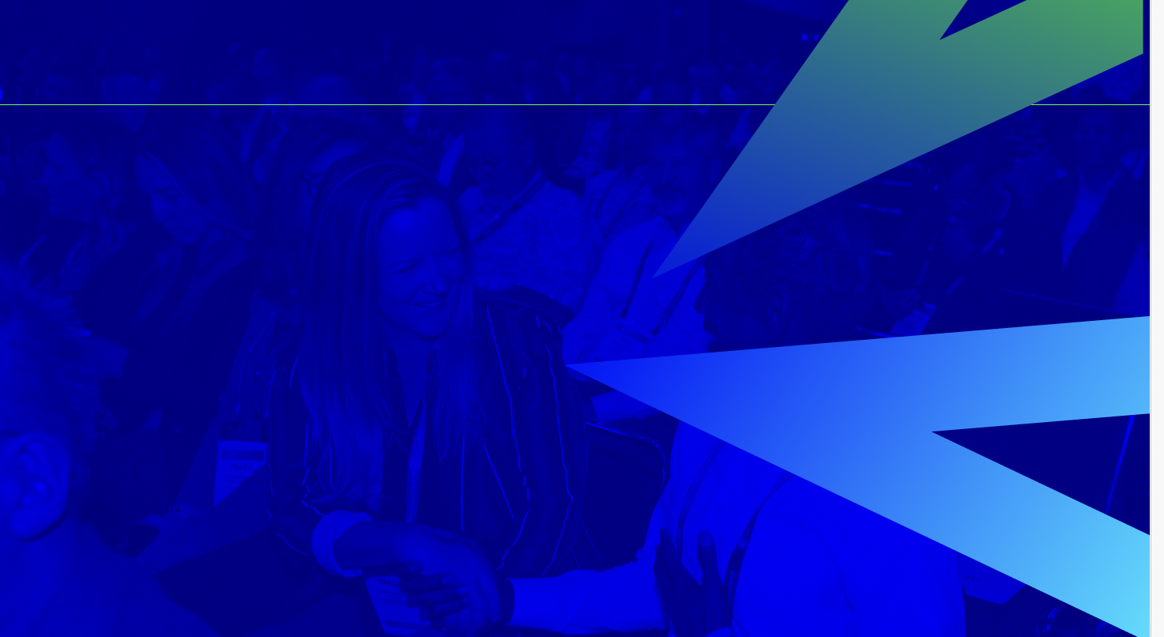
Press Lounge & Hours
Located on the exhibition floor, the lounge offers designated areas equipped for laptop charging, complimentary refreshments, and two exclusive private briefing rooms.
Open Hours
Tuesday, September 24 | 10:45 am – 6:00 pm
Wednesday, September 25 | 10:45 am – 6:00 pm
Thursday, September 26 | 9:00 am – 1:00 pm

